Slide 1
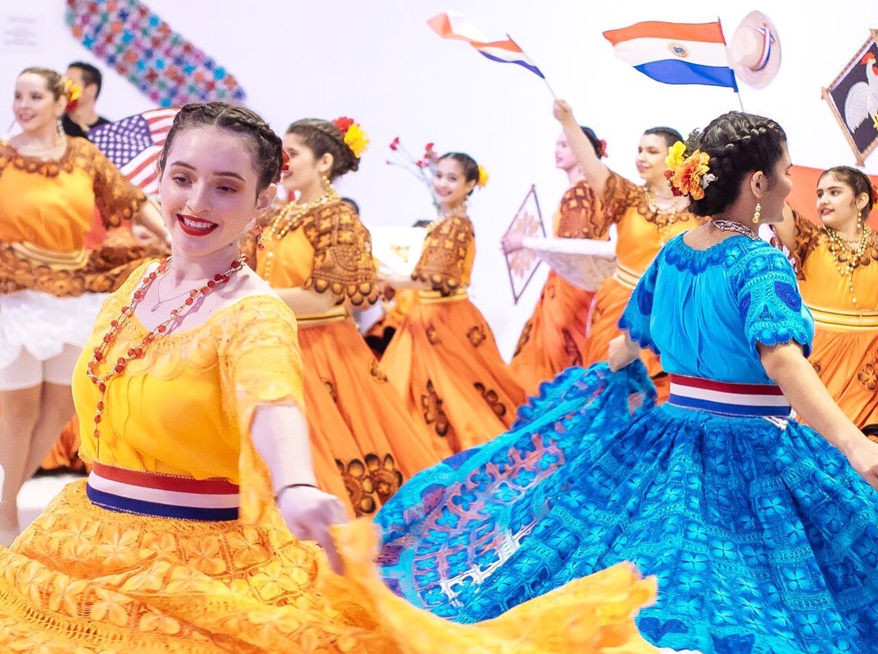
Welcome
ARTS ALIVE 2025

Slide 2
Mission and Vision
ARTSWESTCHESTER’S MISSION TO CREATE AN EQUITABLE, VIBRANT AND SUSTAINABLE WESTCHESTER COUNTY IN WHICH THE ARTS ARE INTEGRAL TO AND INTEGRATED INTO EVERY FACET OF LIFE.
Our Core Values: The arts are for everyone, amplifying the multi-ethnic and culturally diverse voices within our community. The arts offer opportunities for advancement and personal growth. The arts are a catalyst for systemic change, economic development, and community empowerment. The arts create life-affirming experiences, celebrating differences and finding shared values.
Advancing our Mission through Leadership: ArtsWestchester supports the arts in Westchester through leadership, funding, programming, education, advocacy, audience cultivation and professional development. We work to ensure the accessibility and diversity of the arts, at every level for every resident and visitor in Westchester County.
Our Commitment to Social Justice: As ArtsWestchester looks to the future, and in recognition of the current needs of the communities we serve, we reaffirm and further commit to advancing social justice through our policies and practices. We acknowledge that this work is on-going and commit to enacting a strategic vision that is proactive and responsive in shaping a just, fair, and equitable Westchester

Slide 3
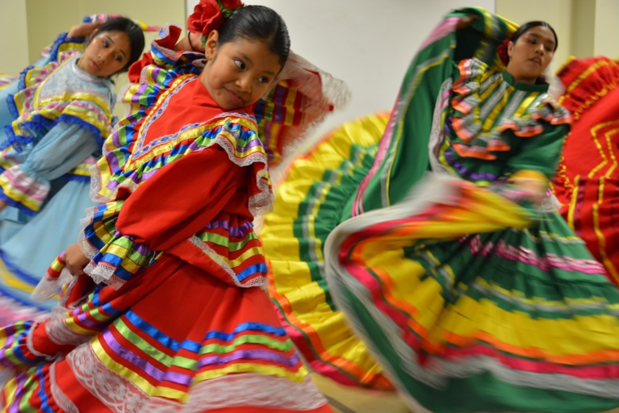
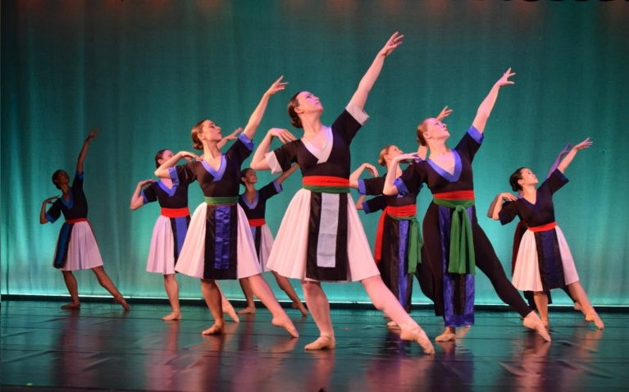
ARTSWESTCHESTER PROGRAMS
Annual season of exhibitions and public programs
County-wide marketing and communications efforts, digital publications of ArtsNews
Grantmaking
Folk and Traditional Arts events
Public Art
Education Initiatives – ArtsMobile, Residencies, mental health
Professional Development/Technical Assistance
Advocacy

Slide 4
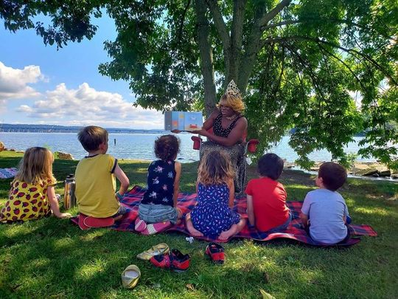
FUNDING CATEGORIES
ArtsWestchester awards over $2 million in grant funding to arts organizations and individual artists annually.
Over our 50+ year history, ArtsWestchester has invested more than $35 million in arts and culture in the region.
Current grant opportunities include:
Arts Alive - Westchester and Rockland
Basic Program Support
Art$W Challenge (non-competitive)
Project Support
Mount Vernon Arts Initiative
Yonkers Arts Initiative
Arts for People with Special Needs
Juneteenth
Voices for Change
Westchester County Poet Laureate

Slide 5
WHAT IS ARTS ALIVE?
The Arts Alive grant category is one of ArtsWestchester’s most effective means of supporting arts activity for Westchester and Rockland County’s geographically, economically and ethnically diverse population. This funding opportunity helps to ensure that residents throughout the region have access to the arts in their communities, particularly in areas where access is limited. Funding is project-specific, and intended for community-based, grantsroote organizations and individual artists.
Arts Alive grants range between $1,000 - $7,500 and can support:
Activities of local arts, cultural, and community organizations and individual artists
Marketing/publicity costs
Artist fees
Administrative expenses directly related to the project
Supplies and materials needed for the execution of the project
Refer to the Guidelines for more details

Slide 6
TIMELINE
Application Deadline:
Tuesday, December 17, 2024 at 11:59PM
Submit by December 11, 2024 to receive feedback on your application. Applicants will be able to make minor edits
Award Notifications: by early May 2025
Project Period: June 1, 2025 – May 31, 2026

Slide 7
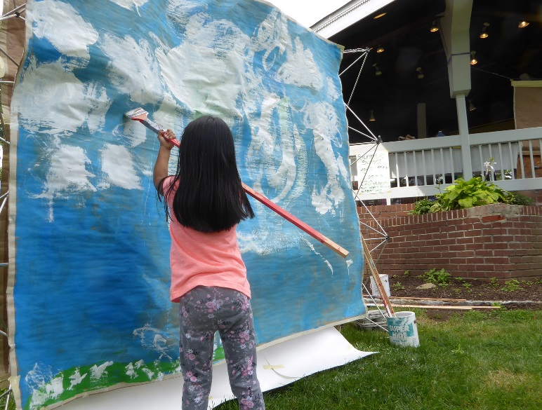
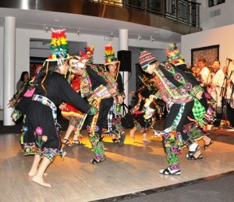
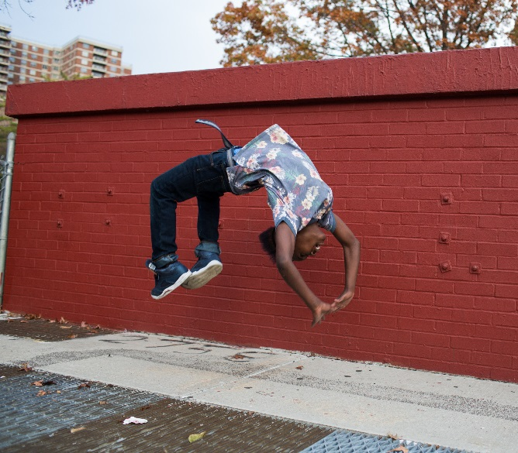
2025 FUNDING CATEGORIES
Community Impact
Individual Artist

Slide 8
ARTS ALIVE: COMMUNITY IMPACT
Community grants provide support for community-based arts and cultural projects developed by arts organizations, groups, collectives, individual artists, and a limited number of other nonprofits that offer open-to-the public arts activities as part of their ongoing operations.
GRANT REQUEST AMOUNT: $1,000 - $7,500
NOTES:
Project must be fully open to the general public, with the exception of Arts Education proposals
In-school partnerships and residencies will be considered within the Community Impact category
Average award is $2,100
Artists or unincorporated groups can apply with a Fiscal Sponsor (optional)
Applicants must be based in the County where the program will take place
Matching funds are not required

Slide 9
ARTS ALIVE: INDIVIDUAL ARTIST
Individual Artist grants provide commissioning support to individual artists for the creation of original, new work created and presented in a community setting.
GRANT REQUEST AMOUNT: $1,000 - $3,000
NOTES:
Supports artist-created work rather than work created by the community under an artist’s direction
Requires the inclusion of community involvement in the creative process or through a public presentation
Emphasis on the actual creation and creative process
Matching funds are not required
Applicants must be artists, not organizations

Slide 10
NEW for 2025
Community Projects now called Community IMPACT
Education is within the Community Impact category
ONE application per artist/organization
Applying with a Fiscal Sponsor is optional
Prioritize engaging new applicants or unfunded returning applicants

Slide 11
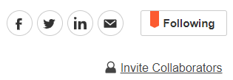
HOW DO I APPLY?
Applications will be accepted online only at
artswestchester.submittable.com
New! Submittable now allows you to invite collaborators to work on your application at the same time.

Slide 12
TIPS & TRICKS
Read the grant guidelines and ask questions
Start and submit your application early
Work samples should be current and representative of your work. If you are performance-based, video/audio footage vs still images are encouraged.
Letters of interest and/or commitment from your proposed venue and support from members of the community are encouraged.
Have your organization fiscal information, EIN number and district information on hand and triple check for accuracy
You will receive a “success” pop up when your application has been successfully submitted
Panel comments available to applicants regardless of outcome

Slide 13
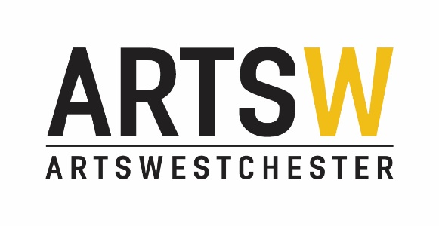
QUESTIONS?
Detailed Guidelines are available online at: https://artswestchester.org/grants/
Contact Grants Staff: grants@artswestchester.org
Sue Abbott, Director of Grant Programs
Jennifer Plick, Associate Director, Grants
Amy Vele, Community Arts Manager

